Slide 1

PRESENTED WASIA, MUHAMMAD HARRIS & UMER AHMED
ANDROCOM
COMMUNICATION WITHOUT INTERNET
FINAL YEAR PROJECT: PART-I

Slide 2

WHAT IS ANDROCOM?
AndroCom is an Android application that allows users to send end-to-end encrypted text messages, make voice calls, and conduct video calls, all without requiring internet access by creating an ad hoc network.

Slide 3

FEATURES OF ANDROCOM
01.
Text Messages, Voice Calls & Video Calls
02.
End-to-end Encryption
03.
Lightweight app & minimal design

Slide 4
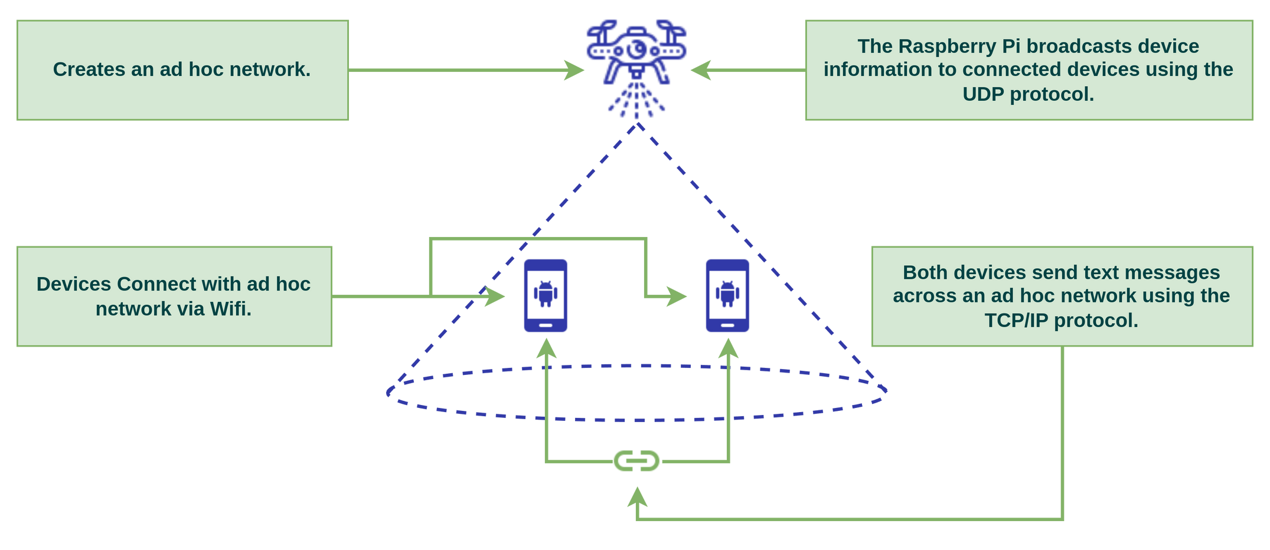
CONCEPT

Slide 5
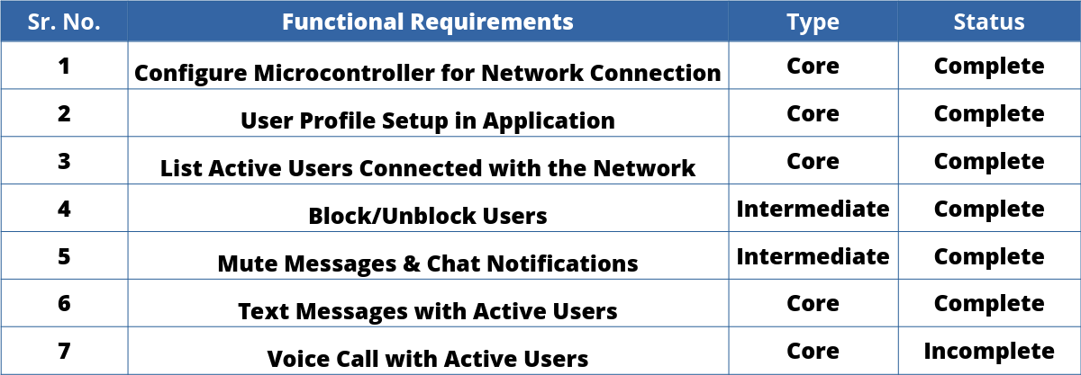
SELECTED FUNCTIONAL REQUIREMENTS

Slide 6
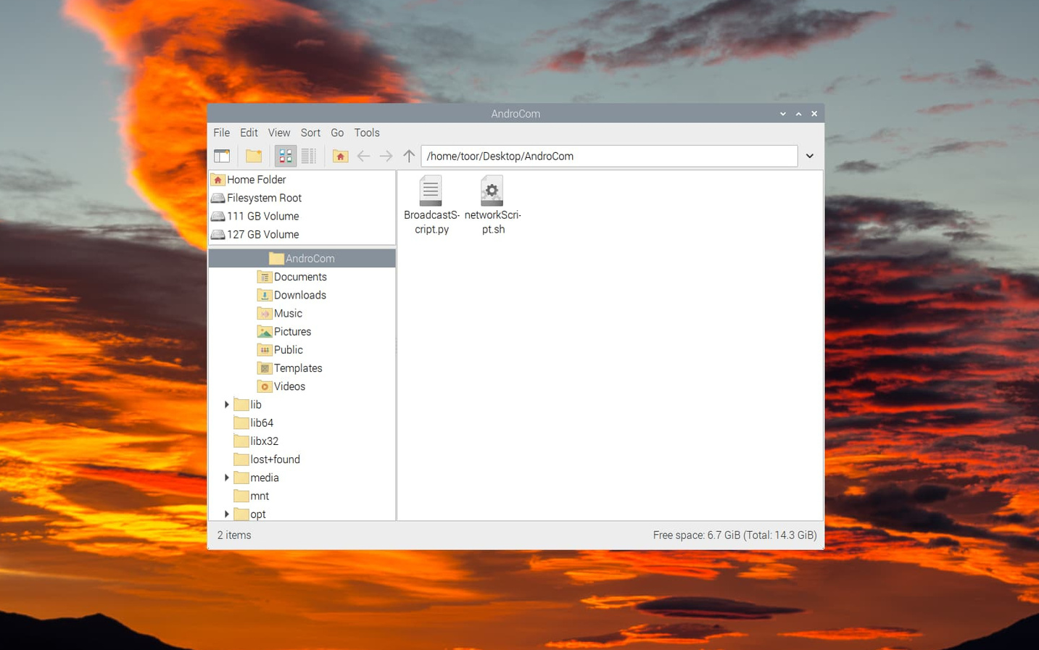
DEPLOYMENT & INSTRUCTIONS

Slide 7
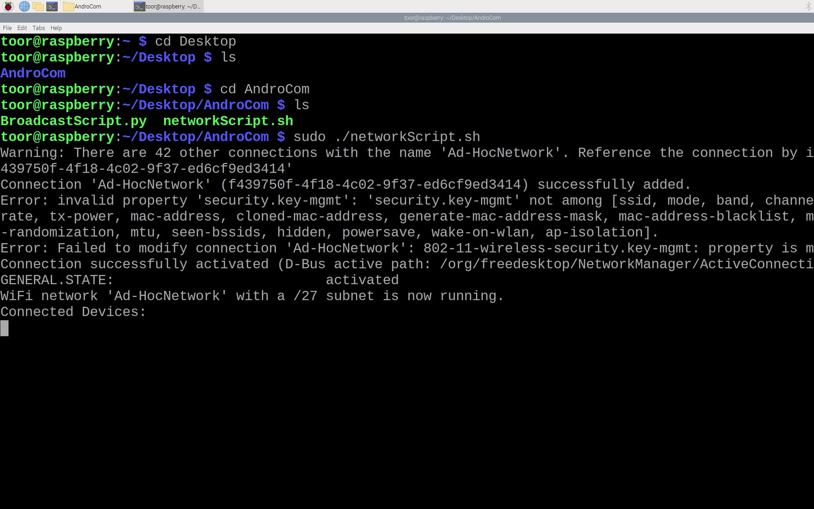

Slide 8
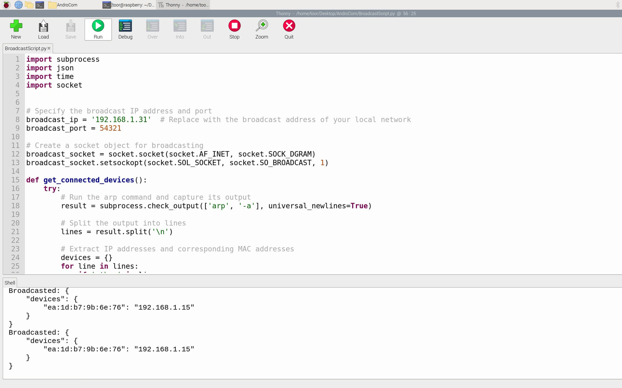

Slide 9

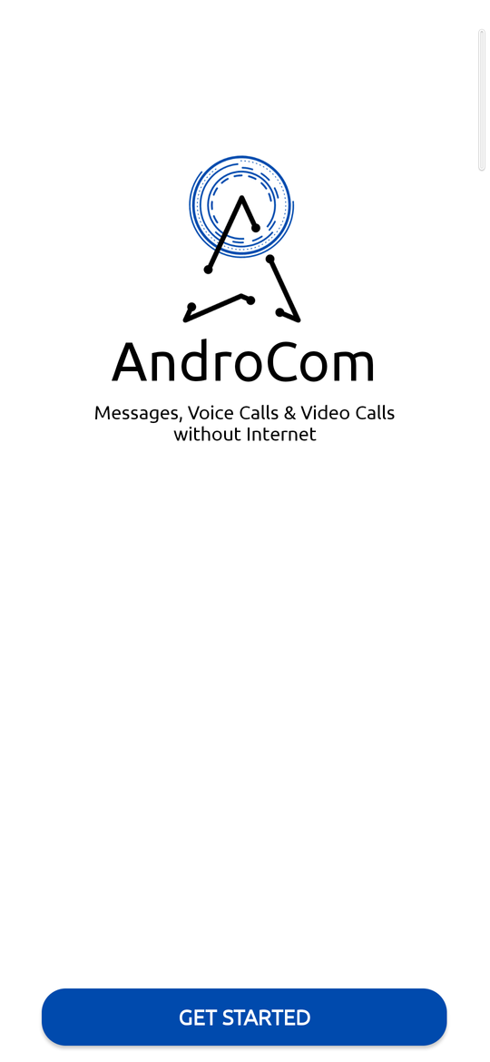
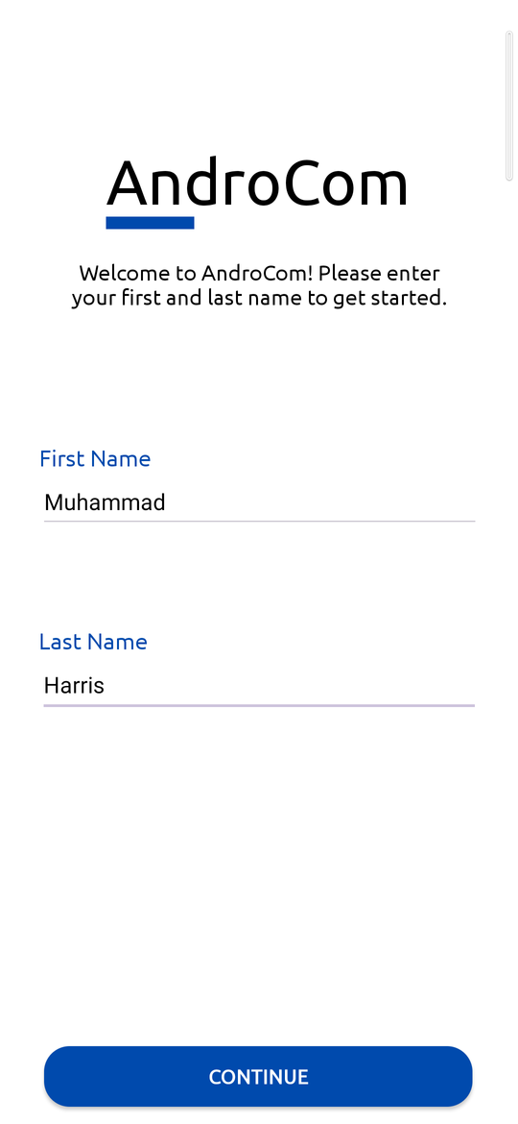

Slide 10
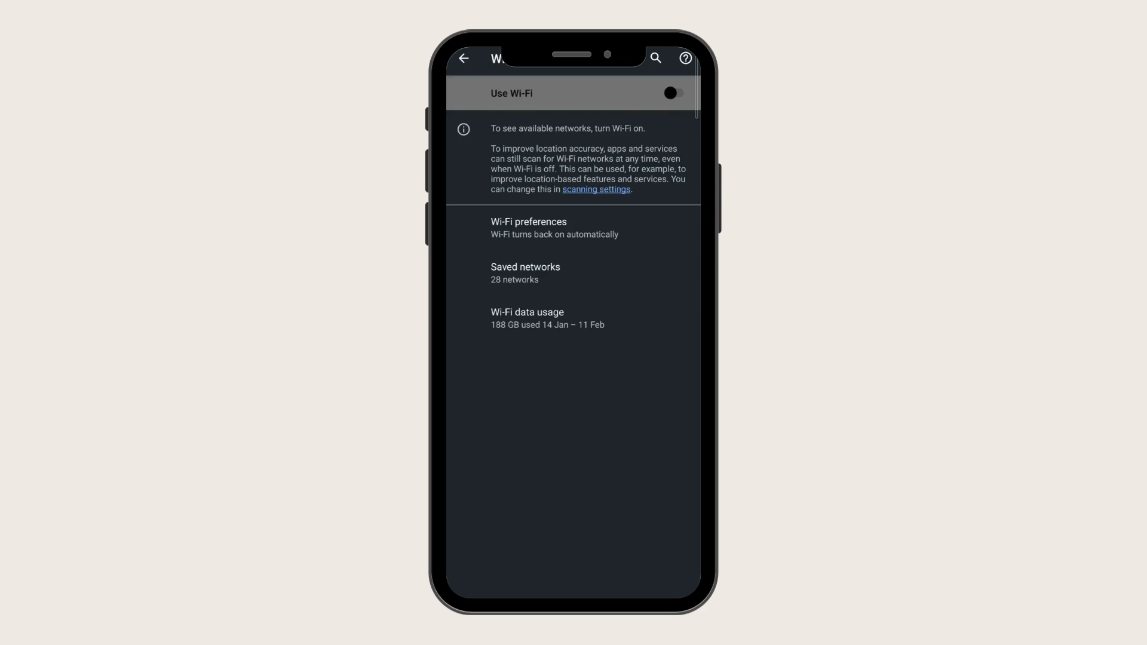
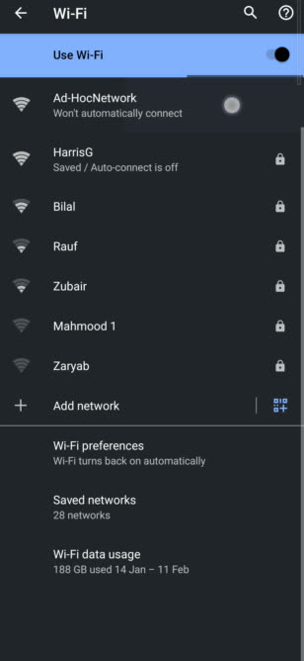

Slide 11

ANY QUESTIONS?
THANK YOU VERY MUCH!
LIVE DEMONSTRATION

